Slide 1
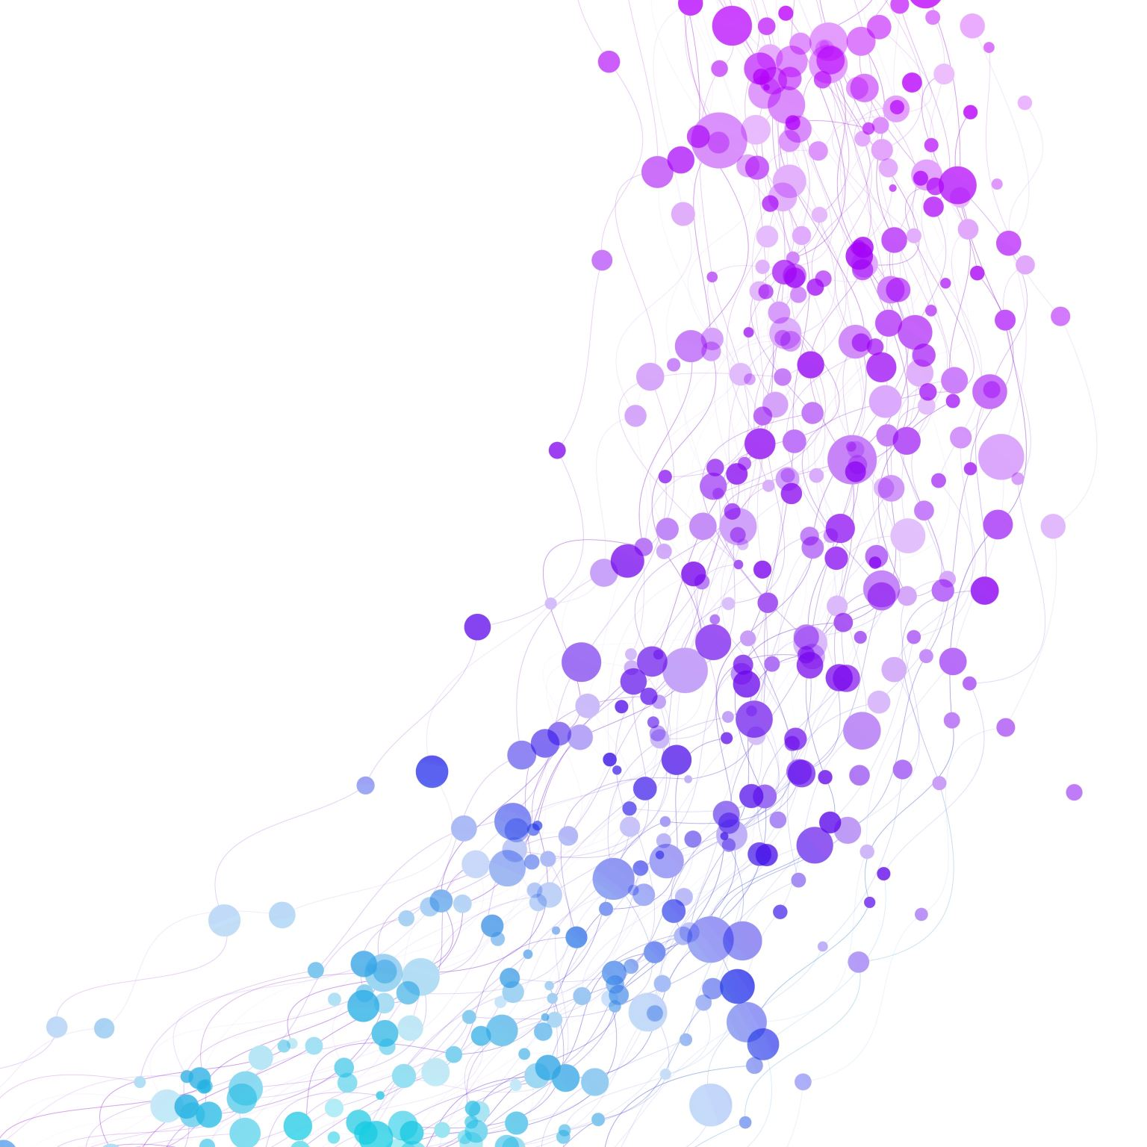
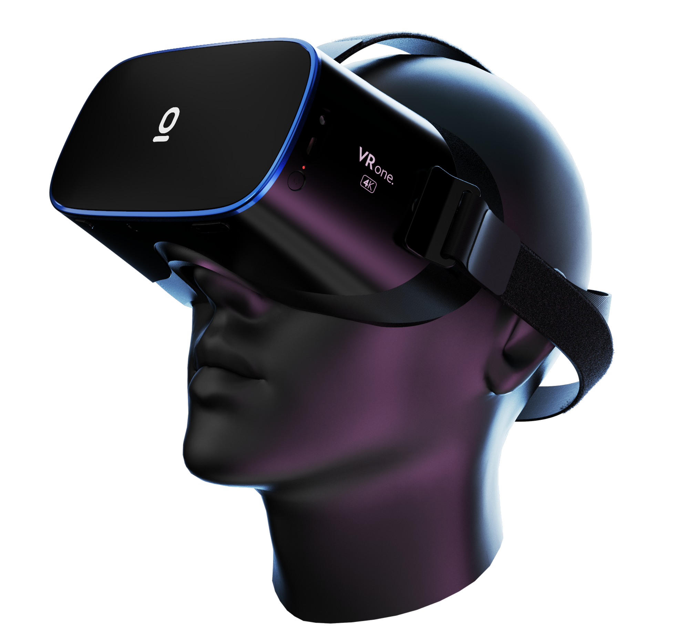

Final Year Project Demonstration
Aziz Alexandros Tarek
BSc Computer Science
Supervisor: Dr. Norman Murray

Slide 2
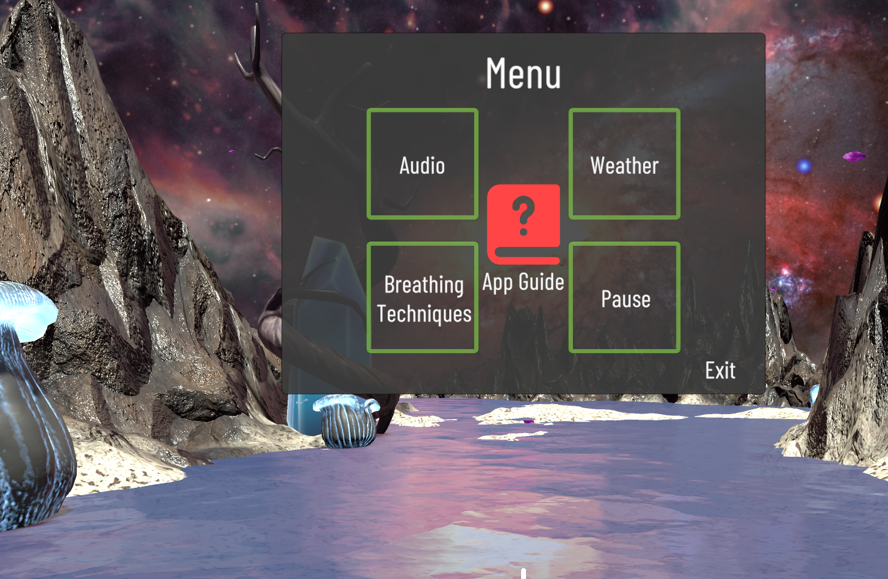
Virtual Reality Meditation App
This project aimed to develop a Virtual Reality application for users to meditate in a virtual space. The app’s goal was to induce calmness and boost the users’ psychological health.

Slide 3

Background
Factors such as working overtime, inharmonious relationships or financial difficulties can cause a great deal of stress.
Naturally, people get interested in ways to manage their stress.
Meditation is a reputable practice to reduce stress.
A creative solution to relax and meditate is practising meditation in a Virtual World.

Slide 4


Aims and Objectives
The main goals were:
Create a natural and an outer space virtual environment.
Research breathing techniques and implement them.
Calculate the tester’s ratings to measure its usefulness.
Evaluate the app’s performance.

Slide 5
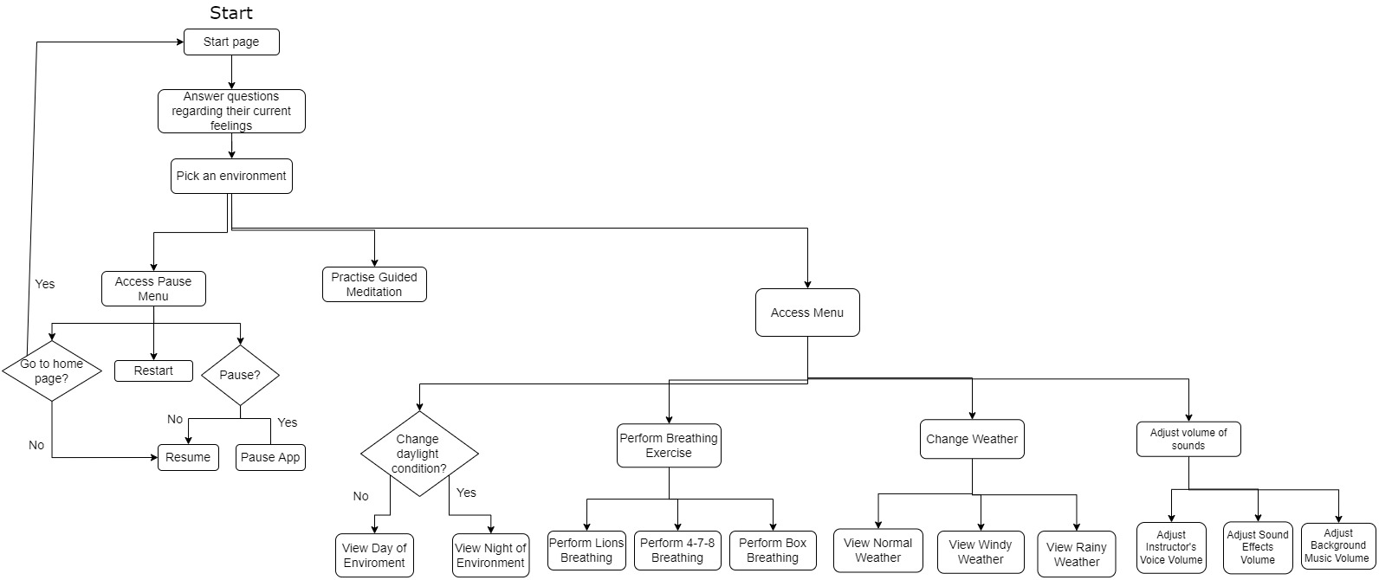
Design
The flow of the system as the user browses it
starting from the start page

Slide 6

Development Challenges
The uncertainty of the efficacy of textual guidance.
The guided meditation would not continue after the guided breathing exercises stopped playing.
Audio of different sound groups such as sound effects, background music etc. were not adjustable from the user interface.

Slide 7

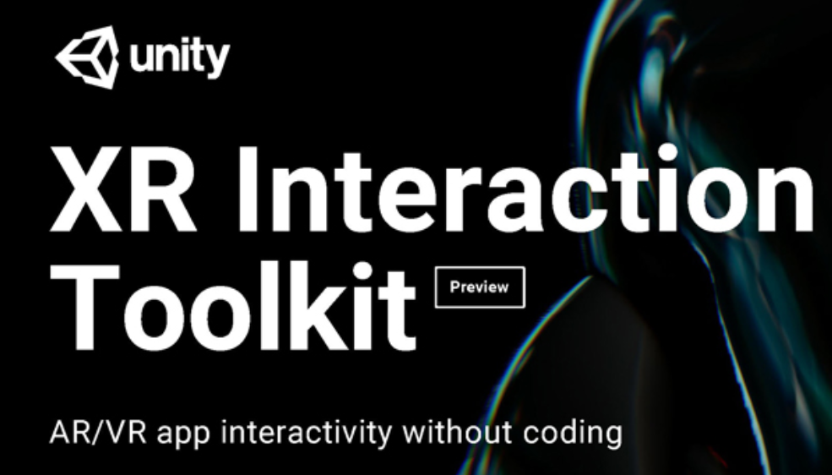

Implementation
The app was developed in 3 sprints. Each sprint (development cycle) lasted for 1-4 weeks.
The Unity game engine was used to develop the app.
To create audio instructions the website Play.ht was used by converting text to speech.
The Unity XR interaction toolkit was used to make the app interactable using VR remote controllers.

Slide 8
Testing
37% agreed that they would continue to use the app if they had the necessary hardware.
8 testers volunteered to rate the app after testing it on a VR headset. The concluding results indicate that:
62% felt that the guided meditation calmed them.
75% found that the breathing exercises were useful.
85% was the average rating the users gave for their
enjoyment of using the app.
Unit testing was conducted to ensure that all functions work properly.
The app’s performance was evaluated using Unity’s built-in tools.

Slide 9
Closing Thoughts & Future Work
I gained knowledge in tasks, such as:
Writing scripts to control the lighting, the sequence of text or audio, position of objects etc.
Managing different audio groups to adjust volume.
It would be beneficial if unit testing in Unity was more comprehensive and simple to execute.
Testing the accessibility of user interfaces in Unity would have been informative.
Possible directions for future work would be:
The use of focus exercises.
Offering a range of meditation techniques.
The addition of more virtual environments.

